Slide 1
Fourier Series
To this point, we have dealt with finite dimensional vector spaces, but there are many applications for vector spaces with infinitely many dimensions. A particularly useful example is Fourier series. Recall that the L² inner product is defined for functions. If f and g are functions over the interval a≤ x ≤ b, then

Slide 2
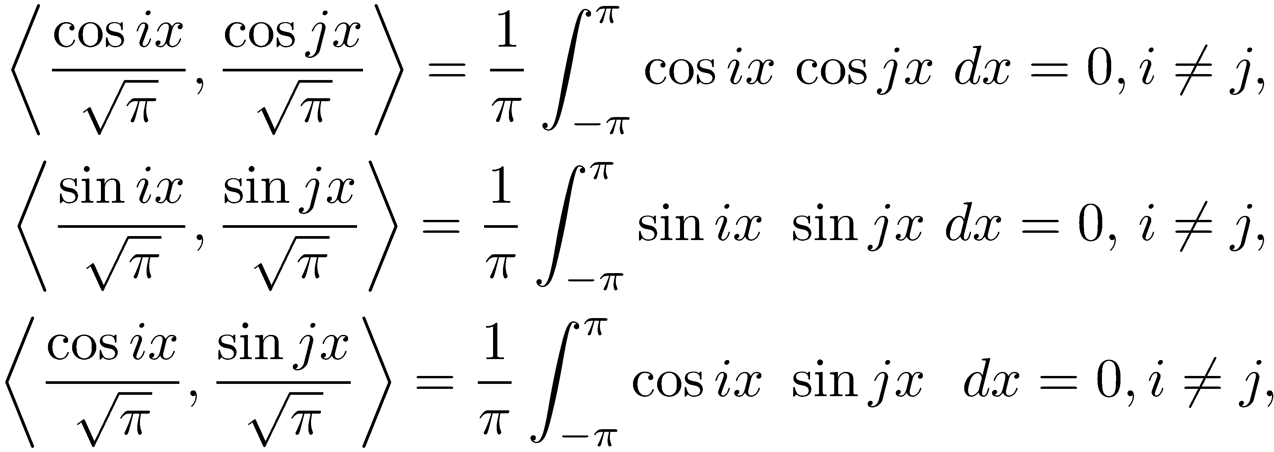
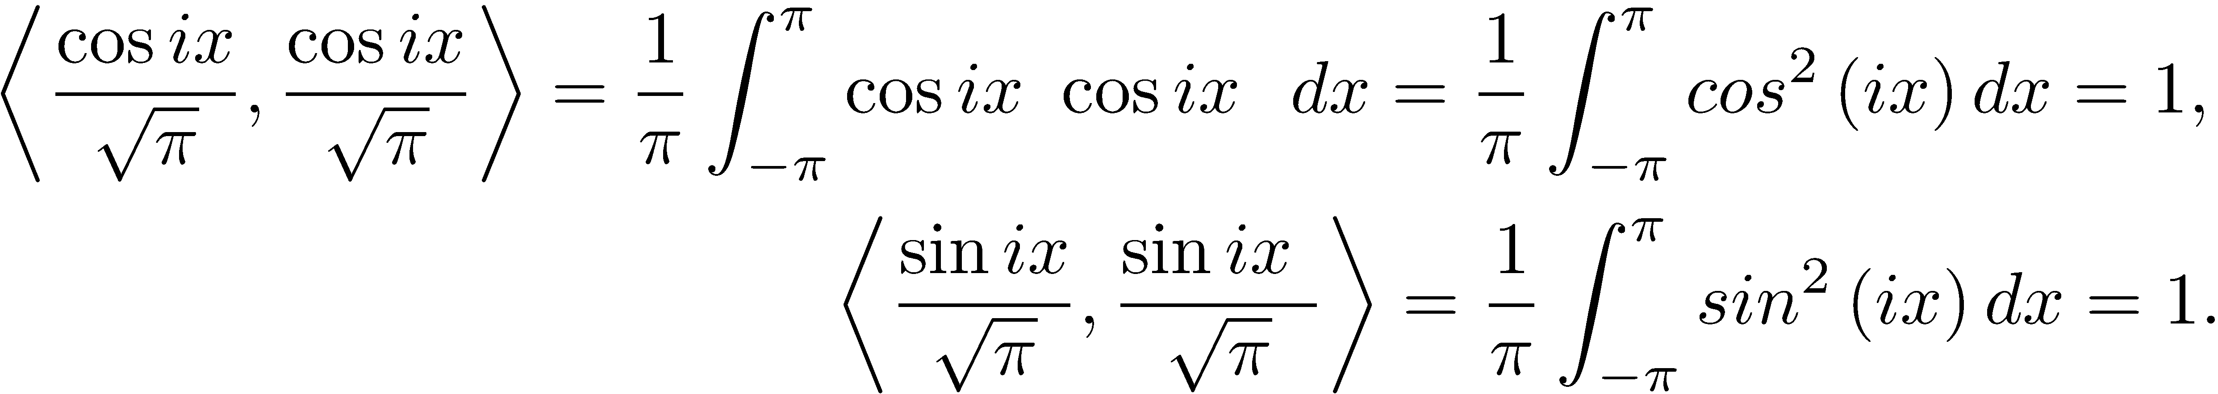
Fourier Series
Consider the infinite sequence of trigonometric functions:
A computation shows this is an orthonormal sequence over the interval –π ≤ x ≤ π.

Slide 3
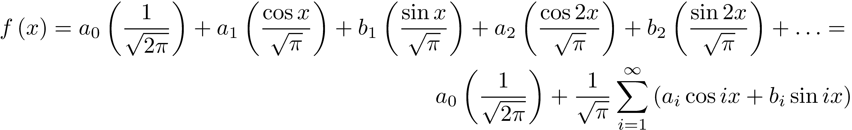
Fourier Series
We consider this infinite sequence to be an orthonormal basis for what we term a function space, a set of linear combinations of the basis functions.

Slide 4
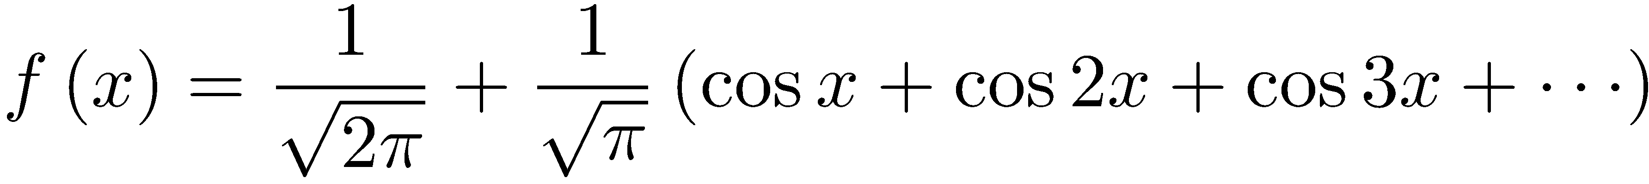
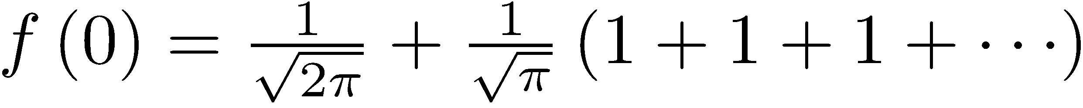
Fourier Series
Not all functions belong to this function space;for instance, let a_{i} = 1, b_{i} = 0, i ≥ 0. In this case, the series is For x = 0, is infinite.
For f to belong to the function space, require that be finite.

Slide 5
Fourier Series
is an
orthonormal sequence, so
For f to be a member of the function space, must be finite.

Slide 6
Fourier Series
When the series converges, we call it the Fourier series for f. Since the function is composed of periodic functions, f is periodic.

Slide 7
Fourier Series
This function space obeys the rules for a vector space. This function space is an example of a Hilbert space, an important mathematical concept that has many applications in electrical engineering, vibration analysis, optics, acoustics, signal processing, image processing, econometrics, chaotic dynamical systems, and quantum mechanics.

Slide 8
Computing a Fourier Series
Assume the Fourier series for f exists. The coefficients a_{i}, b_{i} are called the Fourier coefficients. The formulas for computing them rely on the fact that the trigonometric functions are an orthonormal sequence.

Slide 9
Computing a Fourier Series
Begin with
Multiply both sides by cos kx, k ≥ 1 and integrate from –π to π to obtain
Multiply both sides by sin kx, k ≥ 1, and integrate from –π to π and get
Compute and there results

Slide 10
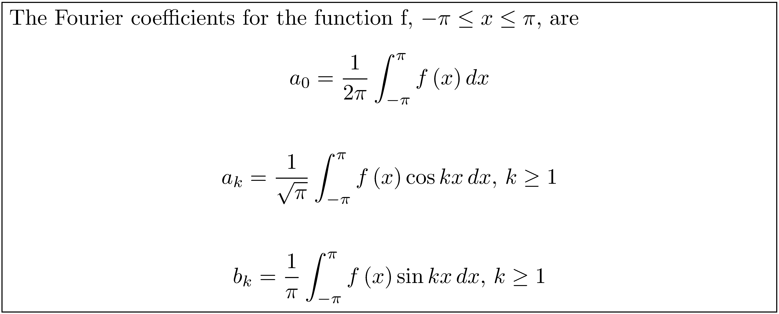
SUMMARY

Slide 11
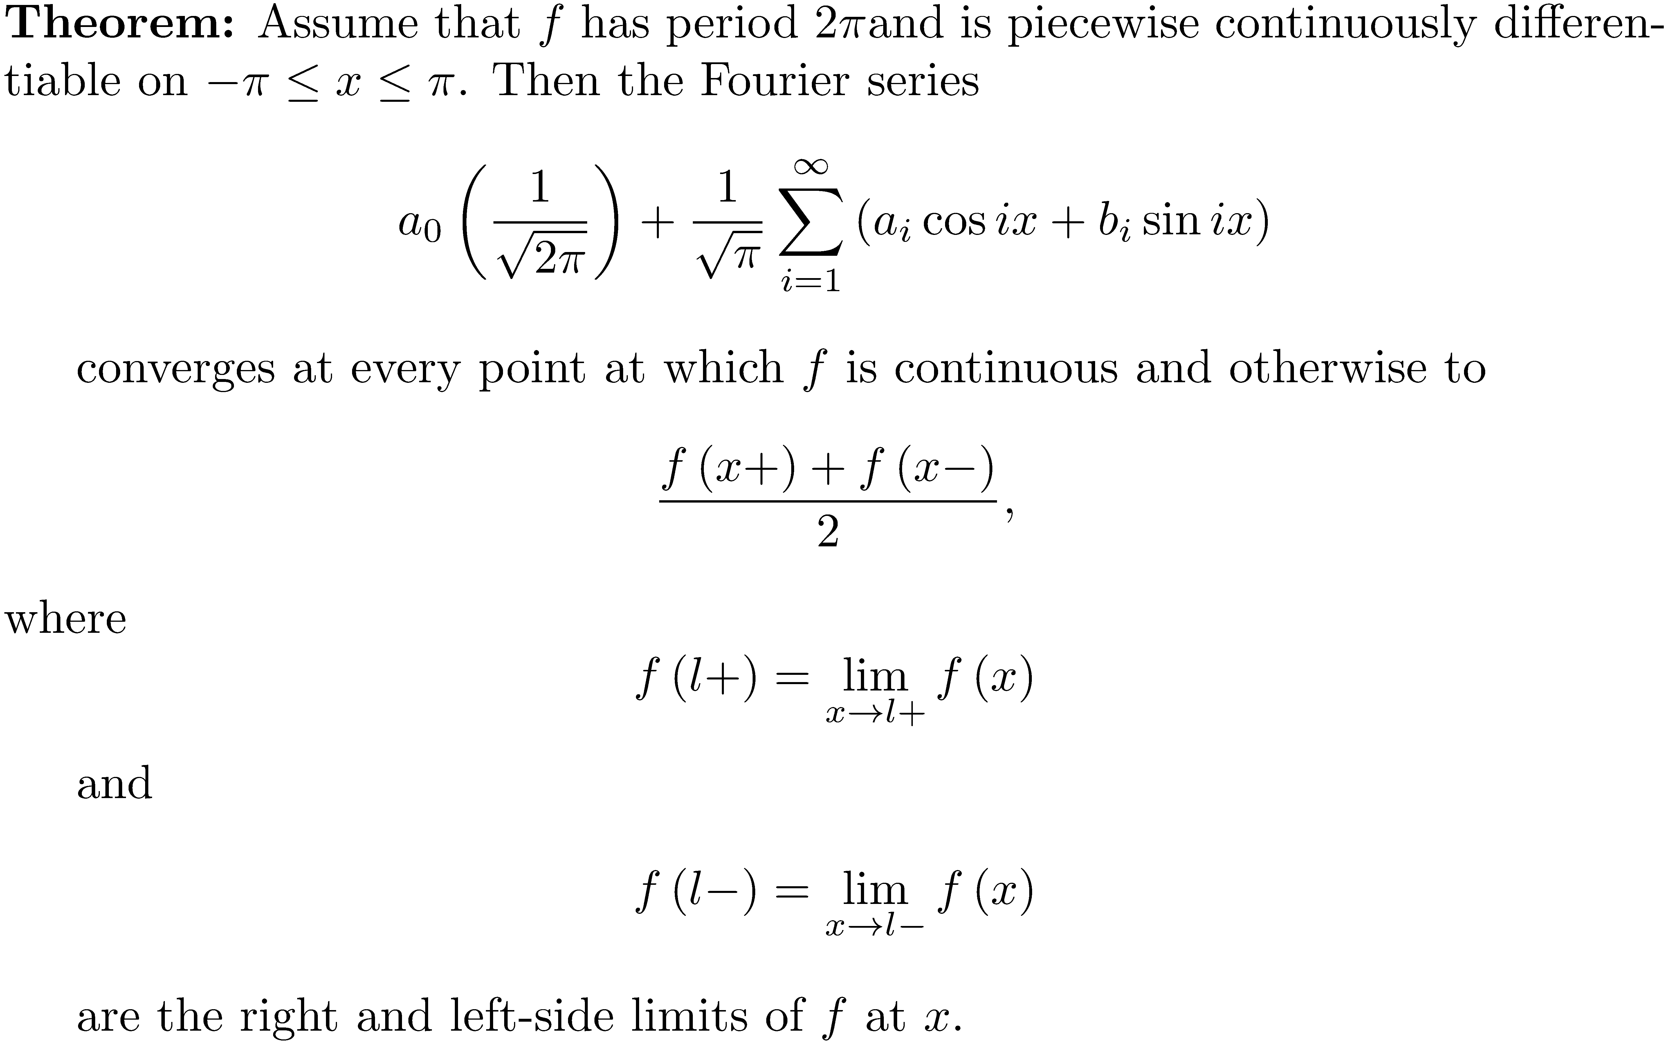
Convergence Result
Now, if we have a periodic function f , is there a Fourier series that converges to f ?

Slide 12
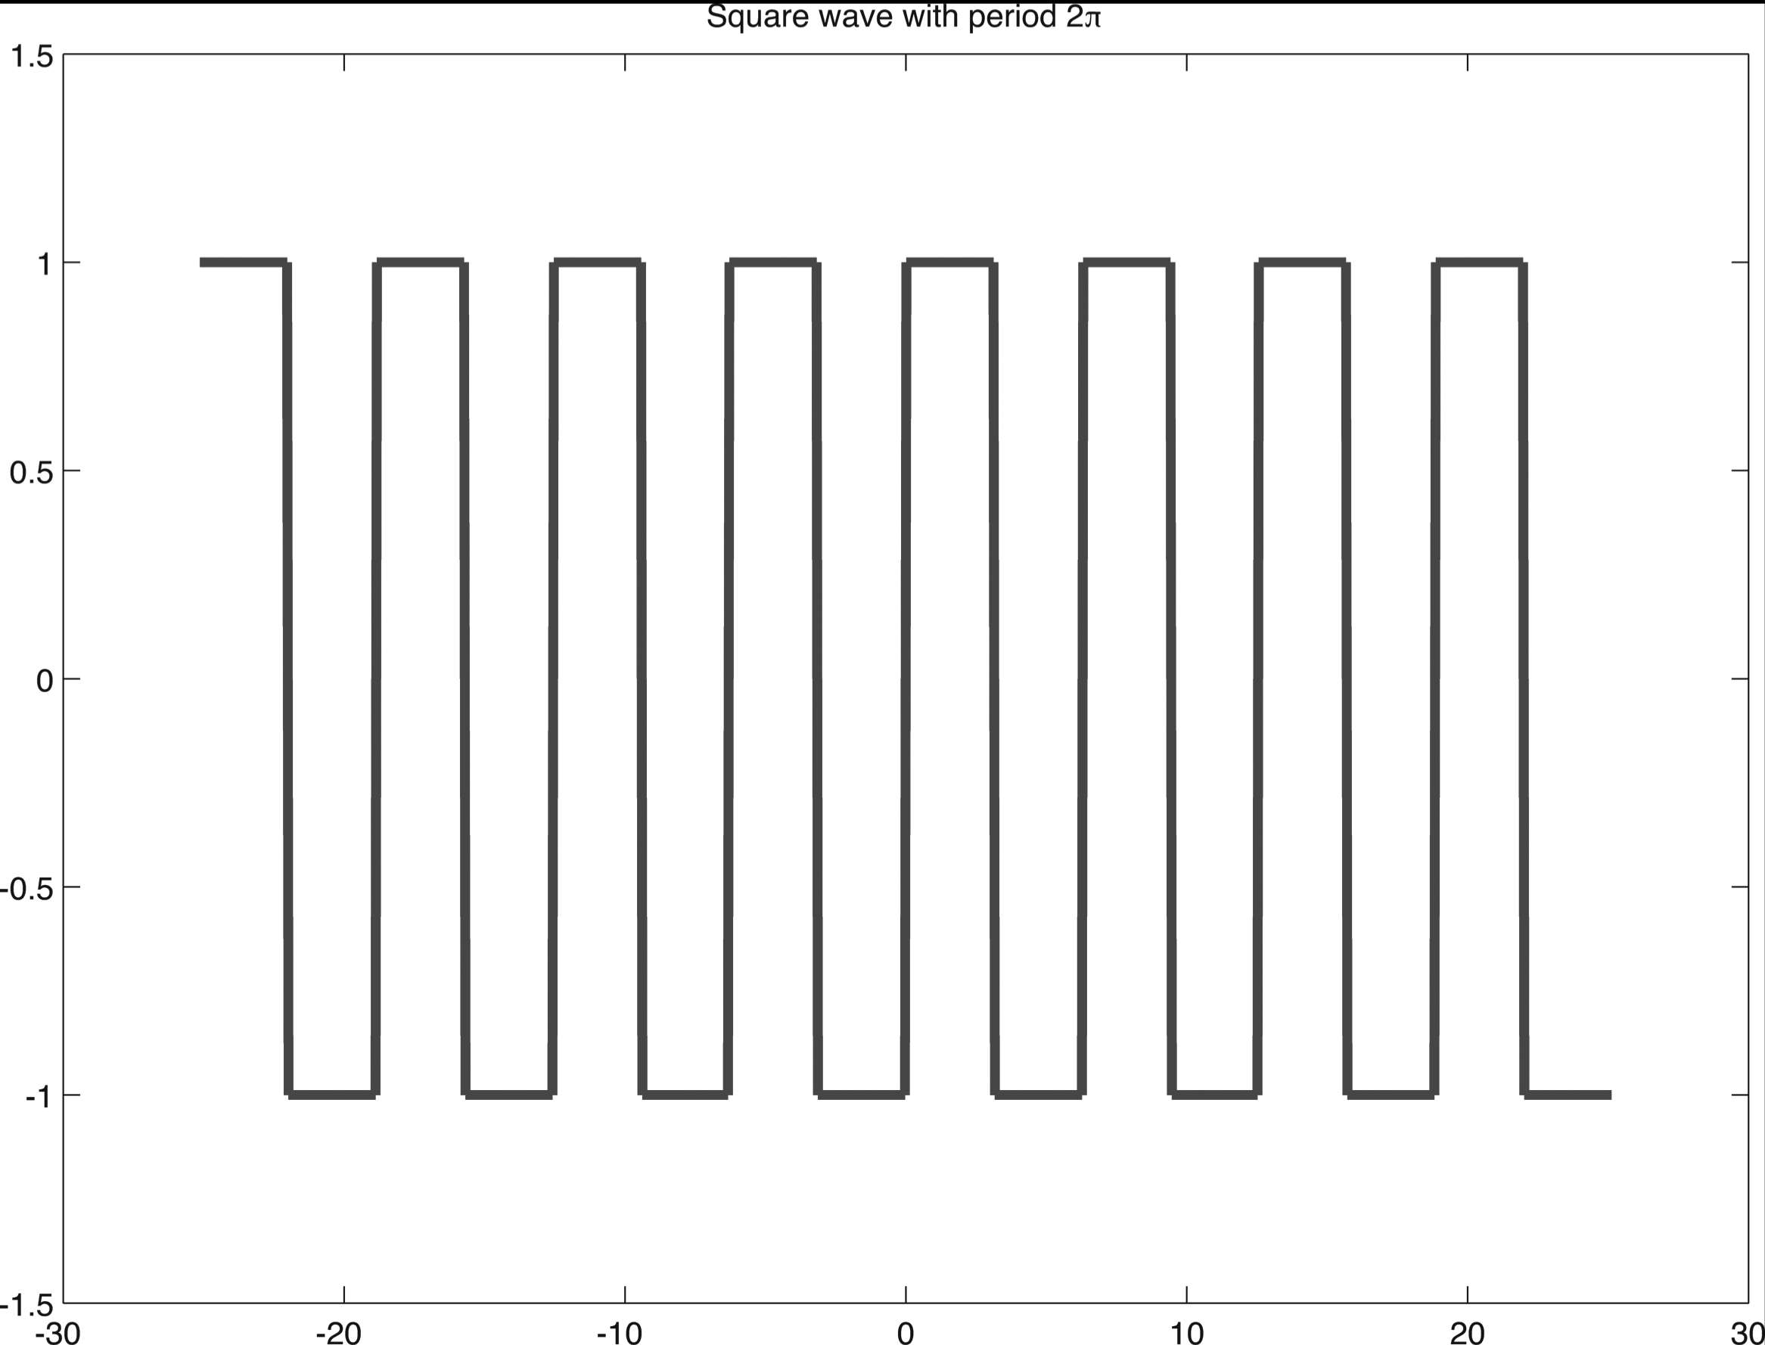
The Square Wave
The square wave is a very useful function in many engineering applications. It is periodic, and in this example has period 2π and is +1 in one-half the period and -1 in the other half.

Slide 13
The Square Wave
The Fourier series for the square wave is not difficult to compute. All the cosine terms in its Fourier series are 0, since the function is odd (f(-x) = -f(x)). The series is

Slide 14
The Square Wave
As ,the partial sums of cosine terms “wiggle less and less” and converge to the line segments comprising the wave.

Slide 15
The Square Wave

Slide 16

Square Wave Sound
Sound can travel as a square wave. The amplitude alternates at a constant frequency between fixed minimum and maximum values (+1 and -1 for our wave), with the same duration at minimum and maximum. The sound is somewhat nasal, as you can see by playing the sound.
Only odd harmonics are present, so the square wave is the superposition of an infinite number of odd harmonics.

Slide 17
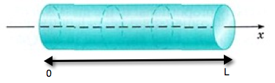
Steady State Heat and Diffusion
A thin rod is given an initial temperature distribution, then insulated on the sides. The ends of the rod are kept at the same fixed temperature; e.g., suppose at the start of the experiment, both ends are immediately plunged into ice water. We are interested in how the temperatures along the rod vary with time. Suppose that the rod has a length L (in meters), and we establish a coordinate system along the rod as illustrated.

Slide 18
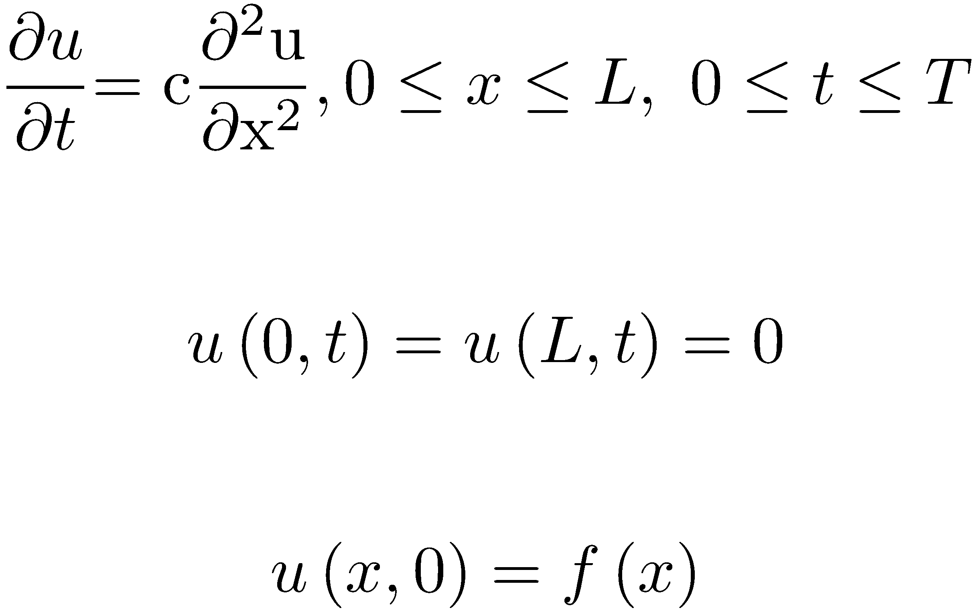
The Heat Equation
Let u( x,t ) represent the temperature at the point x meters along the rod at time t (in seconds). Start with an initial temperature distribution u( x,0 ) = f(x) . This problem is modeled using a partial differential equation, where the constant c is the thermal diffusivity.

Slide 19
The Heat Equation
For most functions f(x) , we cannot obtain an exact solution to the problem, so we must resort to numerical methods. So where does linear algebra come in?

Slide 20
The Heat Equation
Divide the space interval into small subintervals of length h = L/m, and the time interval into small subintervals of length k = T/n, where m and n are integers. Using finite differences, approximate u(x,t) at the grid points
and denote this approximate solution by

Slide 21
The Heat Equation
Subdivisions of the x and t axes

Slide 22
The Heat Equation
If m and n are large, the values of h and k are small, and we can approximate each derivative at the point using finite difference equations.

Slide 23
The Heat Equation
Equate these approximations to obtain
and
Defines an (m-1) × (m-1) system of equations for the u_{ij}.

Slide 24
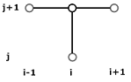
The Heat Equation
Locally related points in the grid.
General pattern of the
four points used in each
difference equation.
Boundary and initial
values.

Slide 25
Matrix Formulation of the Heat Equation
Accounts for boundary
and initial conditions.
Tridiagonal matrix. Can
use the Thomas algorithm.

Slide 26
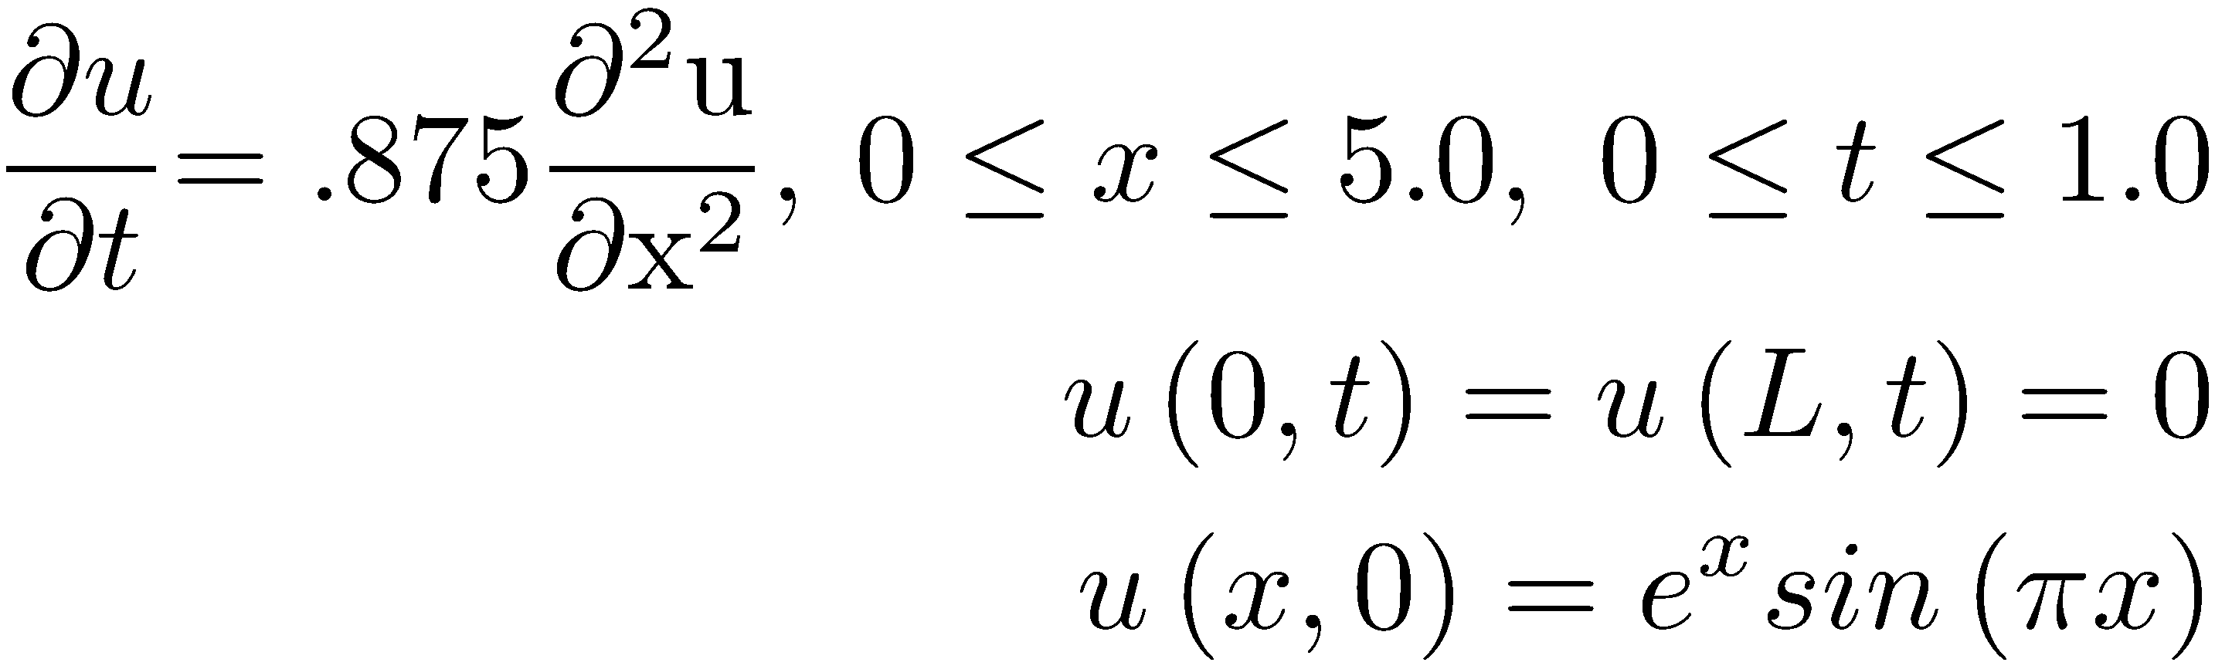
Heat Equation Example
Approximate and graph the solution of the following heat equation:

Slide 27
Heat Equation Example
Use the MATLAB function heateq.m to approximate and graph the solution.
f = @(x) exp(x).*sin(pi*x);
g1 = @(t) 0;
g2 = @(t) 0;
L = 5.0;
T = 1.0;
m = 125;
n = 5000;
c = 0.875;
[x, t, u] = heateq(f,g1,g2,L,T,m,n,c);

Slide 28
Solution Graph

Slide 29
Least-Squares
Assume that during an experiment, you collect m measurements of a quantity y that depends on a parameter t; in other words, you have the set of experimental points . Use those experimental points to approximate data values inside (interpolation) and outside (extrapolation) the range t₁ ≤ t ≤ t_{m}.
TexPoint fonts used in EMF.
Read the TexPoint manual before you delete this box.: AAAAAAAAA

Slide 30
Least-Squares
One approach to the problem is to fit a polynomial to the data in the "least-squares" sense. Assume the polynomial is
Fit the polynomial by minimizing the squares of the deviation of each data point from the corresponding polynomial value; in other words, find the polynomial that will minimize the residual

Slide 31
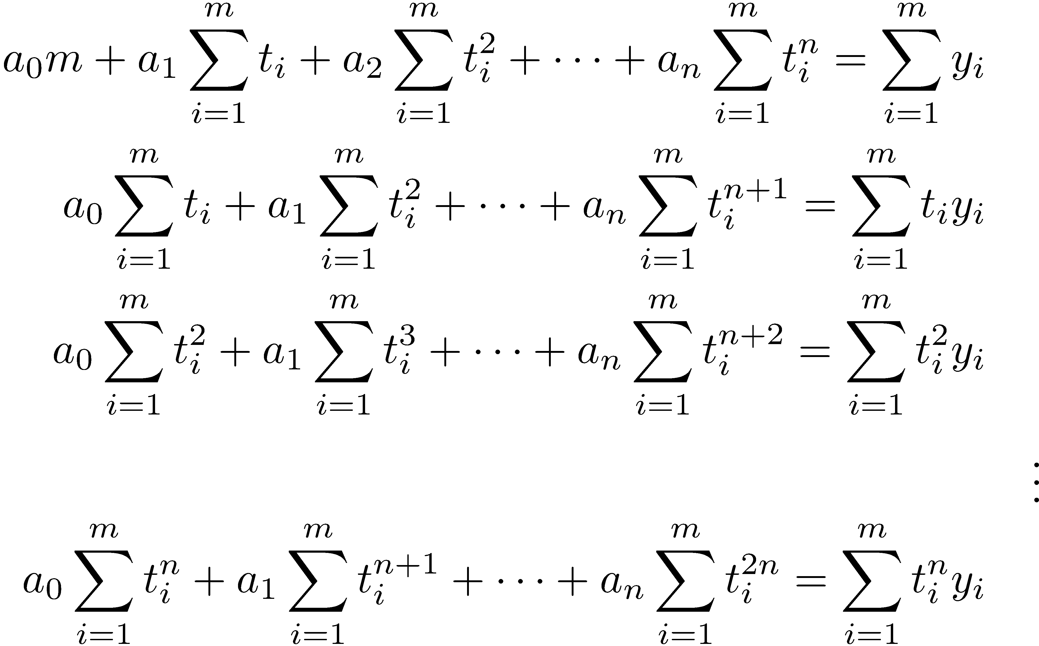
Least-Squares
Set each partial derivative to 0:

Slide 32
Least-Squares
Let , and write the system as a matrix equation
This is a system of n+1 equations in n+1 unknowns a₀ , a₁ , … , a_{n} .

Slide 33
The Vandermonde Matrix
The Vandermonde matrix can be used to conveniently formulate the least-squares system of equations as a matrix problem.
The Vandermonde matrix is the m × (n+1) matrix

Slide 34
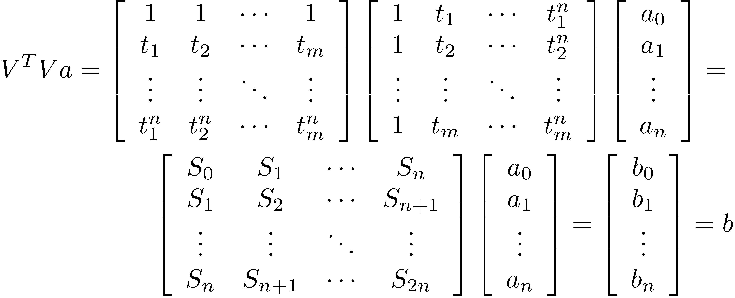
The Vandermonde Matrix
Let and
Form

Slide 35
The Vandermonde Matrix
We have two equations that evaluate to b, so
V has dimension m × (n+1), so V^{T}V has dimension (n+1) × (n+1). The dimension of V^{T}y is (n+1) × 1, so is an (n+1) × (n+1) system of equations.

Slide 36
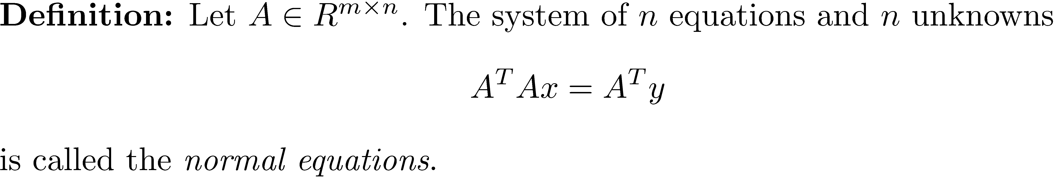
The Normal Equations
Normal equations will become very important when we discuss general linear least-squares problems in Chapter 16.

Slide 37
The Normal Equations and Polynomial Least-Squares Fit
To fit a polynomial of degree n to the data points , execute the following steps.
Form the Vandermonde matrix V.
Compute V^{T}y = b.
Solve the (n+1) × (n+1) system for the coefficients a_{i}, 0 ≤ i ≤ n, of the polynomial

Slide 38
Least-Squares Example 1
The following are 8 data points show the relationship between the number of fishermen and the amount of fish (in thousand pounds) they can catch a day.
Number of Fishermen | Fish Caught
4 | 7
5 | 8
9 | 9
10 | 12
12 | 15
14 | 20
18 | 26
22 | 35

Slide 39
Least-Squares Example 1
Fit a line and a parabola to the data and estimate how many fish 16 fishermen can catch in a day.

Slide 40
Least-Squares Example 1(linear fit)
The Vandermonde matrix V is of dimension 8 × 2 , and its transpose has dimension 2 × 8 , so V^{T}V is a 2 × 2 matrix.
Solve
Solution:
Best fitting line:

Slide 41
Least-Squares Example 1(linear fit)
To estimate the value for 16 fishermen, compute 1.5669(16) - 1.9105 = 23.1591 .

Slide 42
Least-Squares Example 1(Quadratic fit)
Fit a quadratic polynomial to the data.
5.2060 + 0.1539x + 0.0554x²
Best fitting parabola:

Slide 43
Least-Squares Example 1(Quadratic fit)
Estimated value for 16 fishermen

Slide 44
Warning!
In our example, the quadratic polynomial appears to be more accurate; however, using a higher degree polynomial does not guarantee better results. As the dimensions of the Vandermonde matrices get larger, they become ill-conditioned.

Slide 45
The MATLAB Function vandermonde
The following function computes the Vandermonde matrix.
function V = vandermonde(x, m)
%vandermonde Compute the Vandermonde matrix.
%
% V = vandermonde(x,m) forms the Vandermonde matrix for a polynomial
% of degree m with the x-axis data in vector x. V is an n x (m+1)
% matrix, with powers of x-components in columns 2 through (m+1).
n = length(x);
V = ones(n, m+1);
y = zeros(n,1);
y = x;
for i = 2:m+1
V(:,i) = y;
y = y.*x;
end

Slide 46
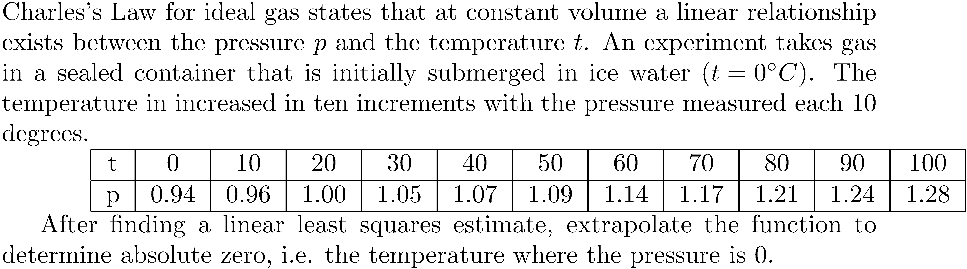
Least-Squares Example 2

Slide 47
Least-Squares Example 2 (MATLAB code)
>> t = 0:10:100;
>> V = vandermonde(t,1);
>> p = [.94 .96 1 1.05 1.07 1.09 1.14 1.17 1.21 1.24 1.28]';
>> b = V'*p;
>> a = (V'*V)\b
a = 0.9336 0.0034
>> abszero_approx = -a(1)/a(2)
abszero_approx = -273.1383
>> temp = [-300 100];
>> plot(t, p, 'o', temp, a(2)*temp + a(1));
>> xlabel('temperature (C)');
>> ylabel('pressure (atm)');
>> title('Extrapolation of Regression Line to Estimate Absolute Zero');

Slide 48
Least-Squares Example 2 (MATLAB code)

Slide 49
Least-Squares Example 3
It is possible to use linear least-squares to approximate data the has an exponential or other shape. For instance, fit a function to the following data.
1 | 3 | 5 | 6.5 | 8 | 15
0.3655 | 0.5436 | 0.8185 | 1.1010 | 1.4860 | 6.0260

Slide 50
Least-Squares Example 3 (MATLAB code)
>> x = [1 3 5 6.5 8 15]';
>> y = [0.3655 0.5436 0.8185 1.1010 1.4860 6.0260]';
>> logy = log(y);
>> V = vandermonde(x,1);
>> lnb = V'*logy;
>> a = (V'*V)\lnb
a =
-1.2062
0.2002
>> m = a(2);
>> b = exp(a(1));
>> f = @(x) b*exp(m*x);
>> t = 0.0:.05:16.0;
>> plot(x,y,'or',t,f(t),'k');
>> xlabel('x');
>> ylabel('y');
>> title(sprintf('Best Exponential Fit y = %.4f e^{%.4f x}',b,m));

Slide 51
Least-Squares Example 3 (MATLAB code)

Slide 52
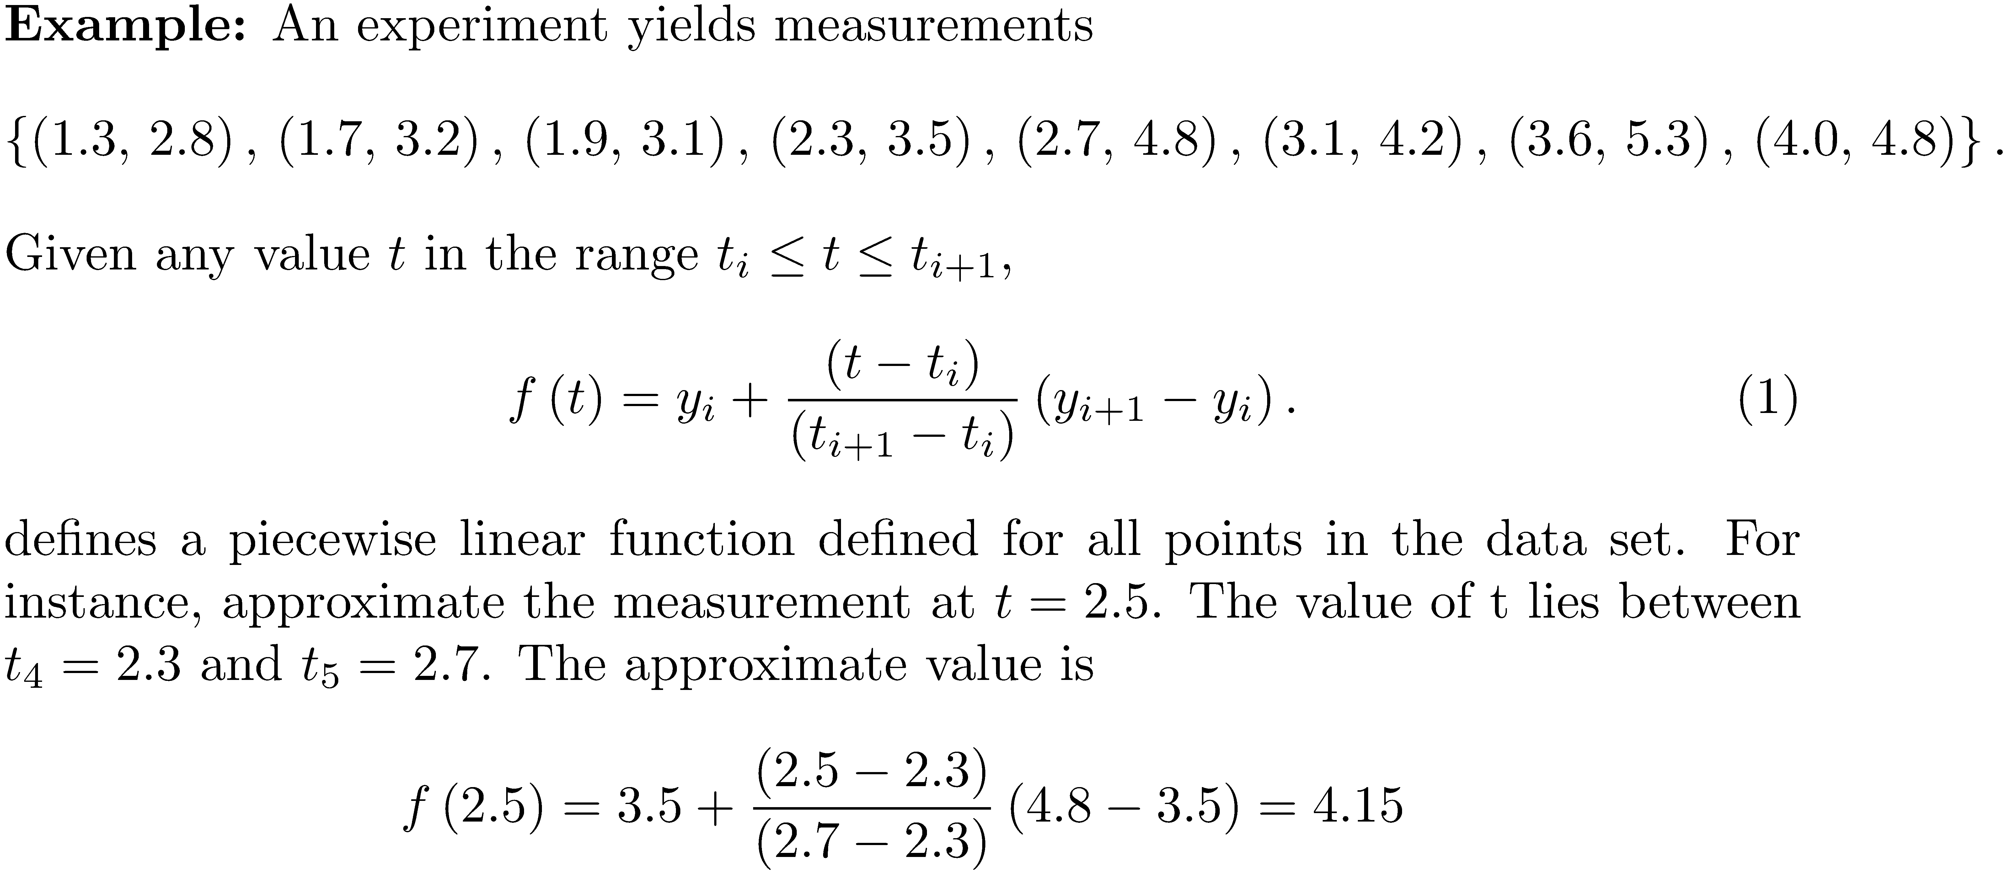
Linear Interpolation
Join data points by line segments, and estimate a value between two data points using a point on the line segment joining the two points.

Slide 53
Linear Interpolation

Slide 54
Cubic Splines
Cubic splines use the same idea, but in a more sophisticated fashion. Instead of using a line segment between two points, use a cubic polynomial to form a piecewise cubic function. The data points t_{i-1} , t_{i} where two polynomials from adjacent intervals meet are called knots.

Slide 55
Cubic Splines
Assume the data points are and that the cubic polynomial p_{i} ,1 ≤ i ≤ n, between t_{i} and t_{i+1} is parameterized by u:

Slide 56
Cubic Splines

Slide 57
Cubic Splines
Requirements are placed on the cubic polynomials so the piecewise polynomial function is twice continuously differentiable. These conditions lead to a system of equations whose solution gives spline coefficients.

Slide 58
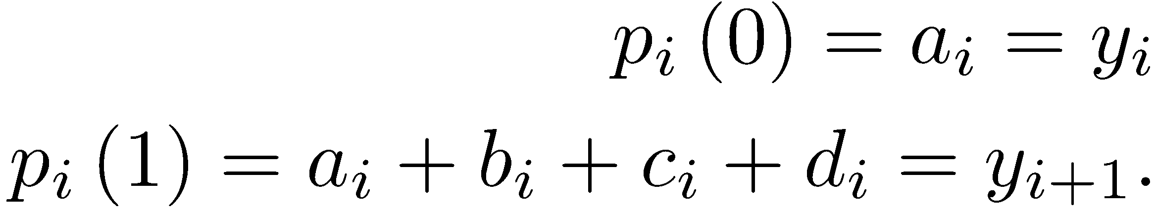
Cubic Spline Requirement 1
The polynomials must agree at the points t_{i} , 2 ≤ i ≤ n , which leads to
NOTE: These conditions make the piecewise polynomial continuous.

Slide 59
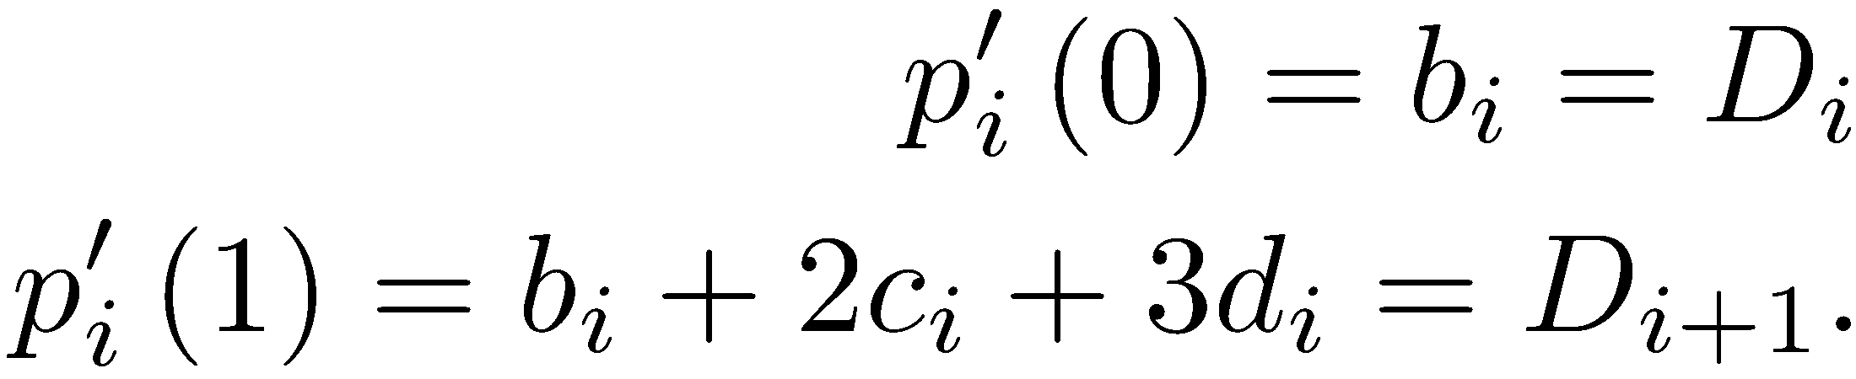
Cubic Spline Requirement 2
Let D_{i} ,1 ≤ i ≤ n+1 be the value of the first derivative of the p_{i} at the knots, and require that at the interior points the first derivatives must agree. This assures that the function defined by the piecewise polynomials is continuous and differentiable. For i=1,2, … n-1

Slide 60
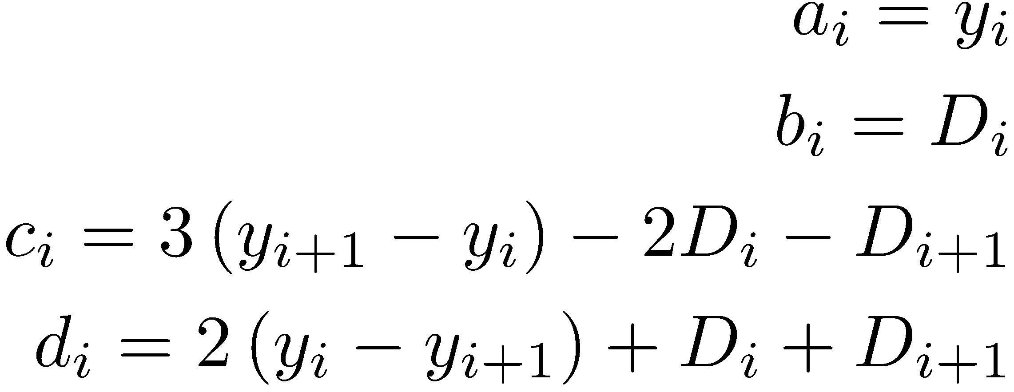
Cubic Spline Requirement 2
Solve the equations for a_{i}, b_{i}, and c_{i} in terms of D_{i} and y_{i} to obtain

Slide 61
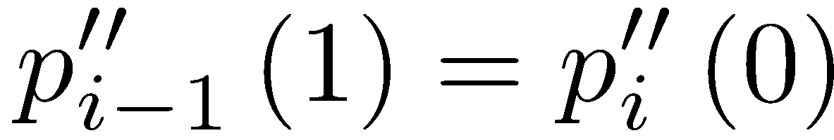
Cubic Spline Requirement 3
At the interior points t₂, t₃, ..., t_{n}, require that the second derivatives of the cubics match ( )
so

Slide 62
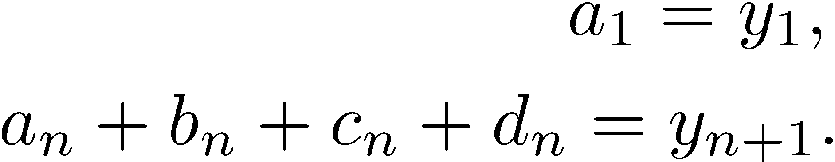
Cubic Spline Requirement 4
Require that p₁ (0)= y₁ and p_{n} (1)= y_{n+1} , which gives

Slide 63
Equations and Unknowns So Far
The current equations are
Equating the polynomial values at the interior points: 2( n-1 ) equations
Equating the first derivatives at the interior points: ( n-1 ) equations
Equating the second derivatives at the interior points: ( n-1 ) equations
Require that p₁ (0)= y1 and p_{n} (1)= y_{n+1} : 2 equations
TOTAL: 4n-2 equations.

Slide 64
Equations and Unknowns So Far
Each cubic polynomial p_{i} ,1 ≤ i ≤ n has 4 unknown coefficients { a_{i} , b_{i} , c_{i} , d_{i} } , so there are a total of 4n unknowns.

Slide 65
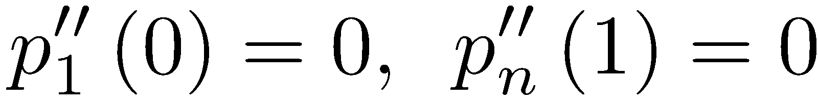
Type of Spline
Have 4n-2 equations and 4n unknowns. We must have two more equations. The choice of equations determines the type of spline.
Require - natural spline.
Require that the third derivatives are continuous at t₂ , and t_{n} - not-a-knot condition.
Specify the value of the first derivative at the endpoints x₁, x_{n+1}. This requires that the derivatives are known or can be estimated there – clamped spline.

Slide 66
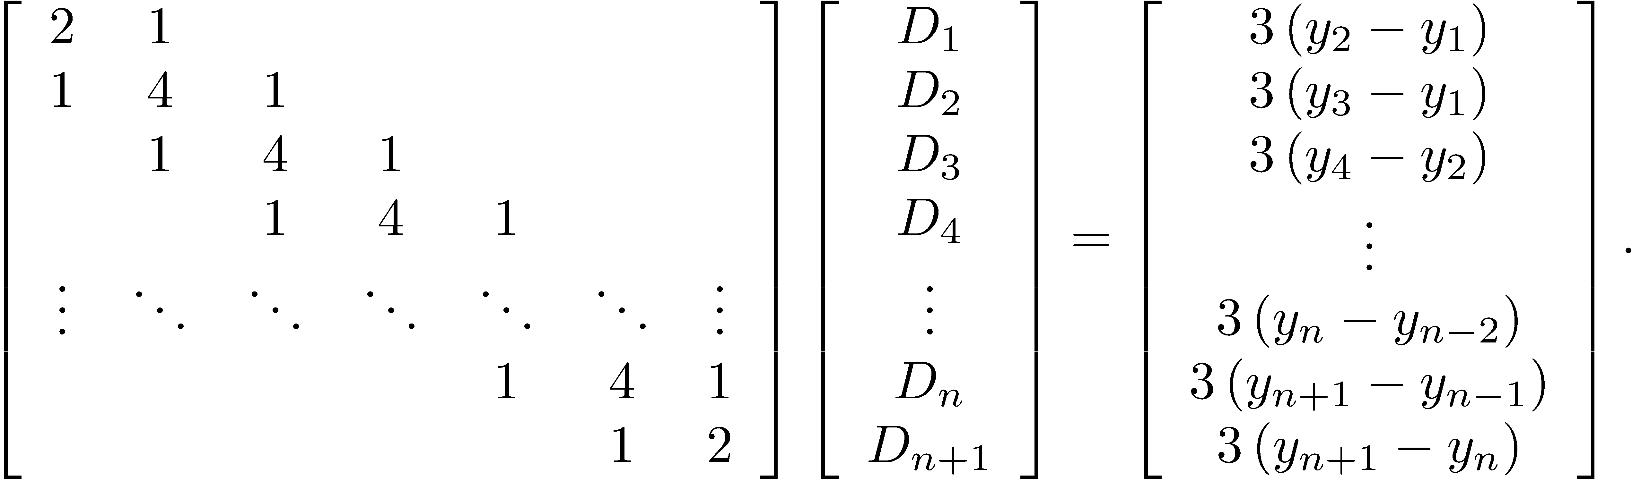
Implementation of Cubic Splines
The 4n × 4n system is not solved for the spline coefficients. Using some mathematical manipulation, it can be shown that This tridiagonal system can be solved for D₁,D₂,…, D_{n+1} efficiently using the Thomas algorithm.

Slide 67
Implementation of Cubic Splines
Apply these equations to find the spline coefficients.

Slide 68
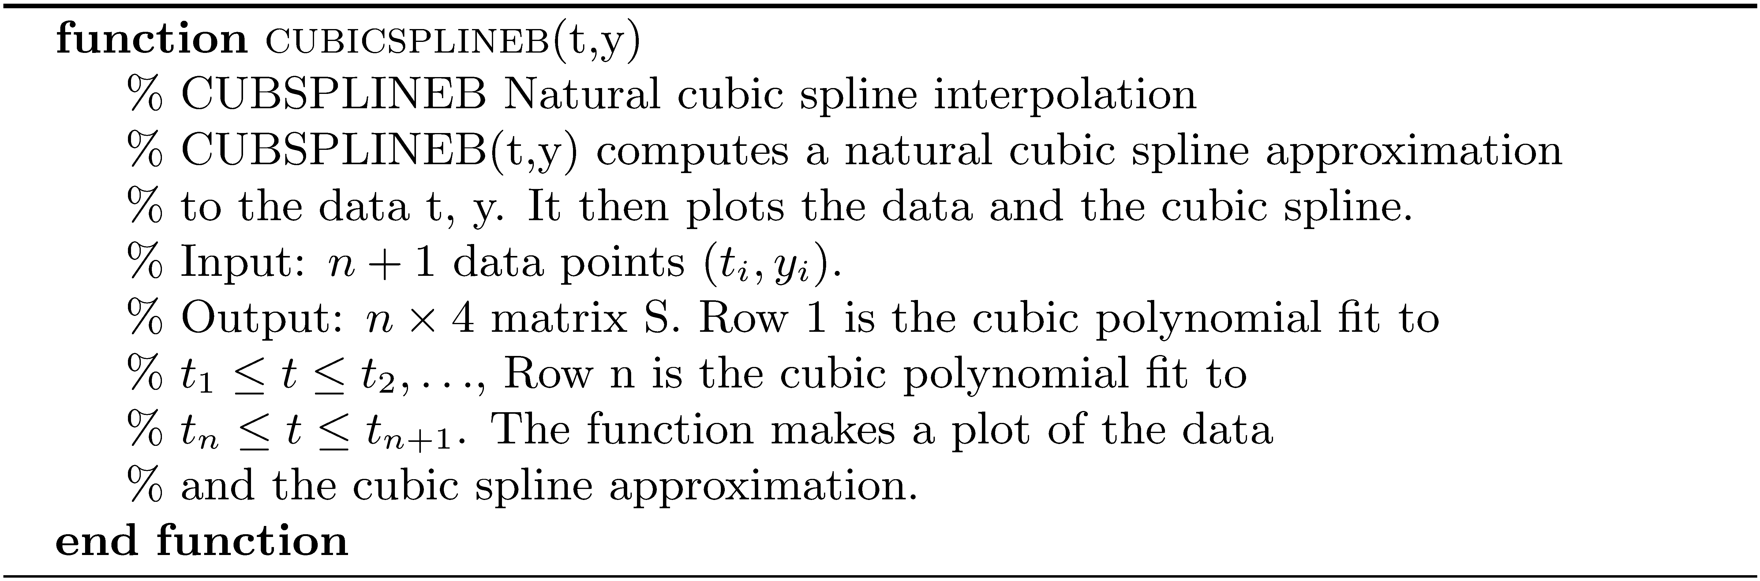
Algorithm cubicsplineb

Slide 69
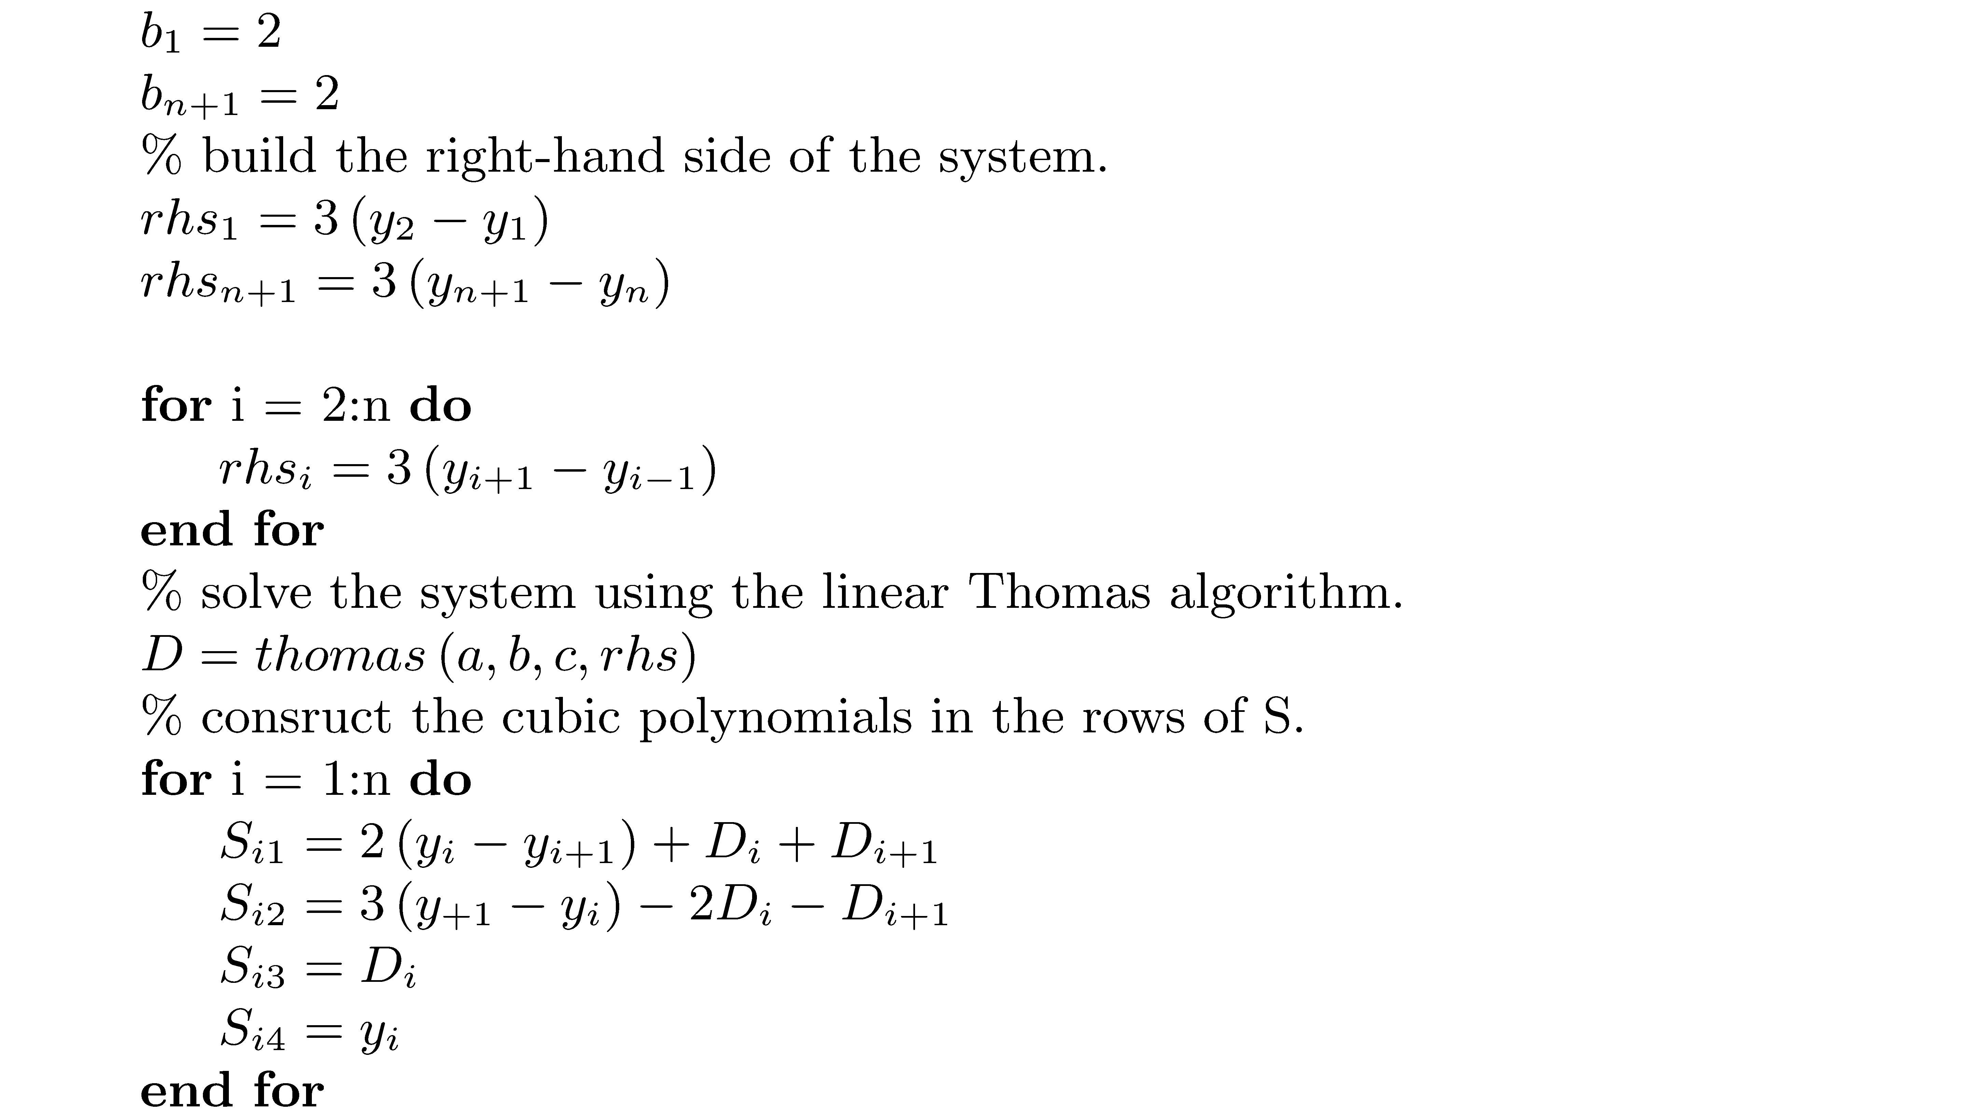
Algorithm cubicsplineb

Slide 70
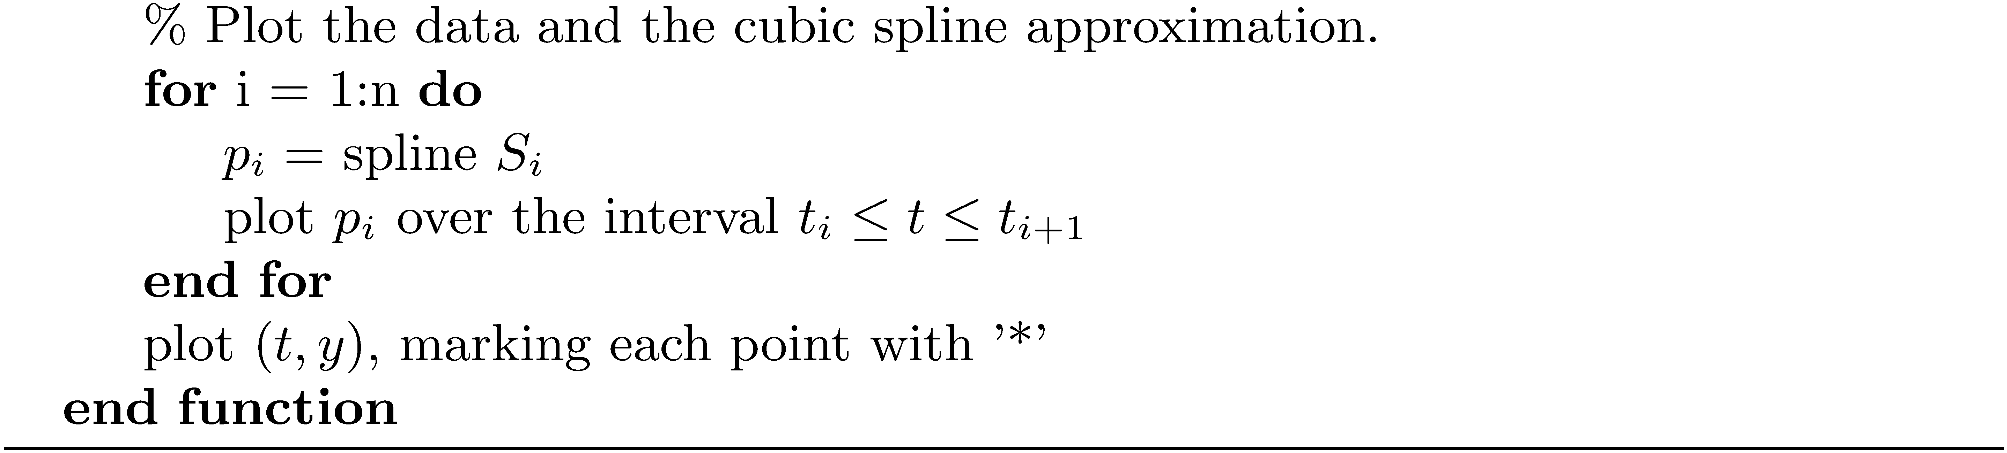
Algorithm cubicsplineb

Slide 71
MATLAB Cubic Spline Example
The following data represent ocean water temperatures at different depths. Estimate the temperature at depths of 50 m, 600 m, and 1400 m.
Depth (m) | 0 | 100 | 300 | 400 | 500 | 750 | 1000 | 1250 | 1500 | 1750
Water temp (°C) | 22 | 21.8 | 21 | 18.7 | 16 | 10 | 5.6 | 4.9 | 4.6 | 4.4

Slide 72
MATLAB Cubic Spline Example
depth = [0 100 300 400 500 750 1000 1250 1500 1750];
temp = [22.0 21.8 21.0 18.7 16.0 10.0 5.6 4.9 4.6 4.4];
S = cubicsplineb(depth,temp);
hold on;
interppt = [50 600 1400];
interpval = zeros(3,1);
for i = 1:length(interppt)
j = 1;
while interppt(i) > depth(j)
u = (interppt(i) - depth(j))/(depth(j+1) - depth(j));
p = S(j,:);
t = polyval(p, u);
j = j +1;
end
fprintf('Approximate value of temperature at %d meters = %.1f\n',...
interppt(i),t);
interpval(i) = t;
end
plot(interppt,interpval,'o');
xlabel('depth');
ylabel('temperature');
title('Ocean Water Temperature at Different Depths');
hold off;
<Run>
Approximate value of temperature at 50 meters = 21.9
Approximate value of temperature at 600 meters = 13.8
Approximate value of temperature at 1400 meters = 4.7

Slide 73
MATLAB Cubic Spline Example

